Slide 1
Chapter 1
Applications of Database

Slide 2





A business organisation that generates lots of transactional data

Slide 3



(From the business perspective) – What are the important information to know?
Which are the top 100 selling products?
Top 100 most profitable products?
What is the contribution(%) of each product to total profit?
Which items are always bought together?
What would be the programming effort required to write programs to answer the above question?
If you have a database system, all these questions could be answered rather quickly and easily.

Slide 4
(From the technical implementation perspective) – system must be efficient in supporting requirements
Amount of transaction per unit time?
No. of concurrent user support?
Duration of data storage?
Data warehousing requirement?
Database distribution strategy? (and much more…)
If you have a DBMS, all these questions could be implemented.

Slide 5
Lesson Outline
Applications of database
DBMS in an enterprise system context
DBMS in application development environment

Slide 6
Lesson Objectives
Examples of database applications
Definitions of terms
History and development of database processing
Purpose of database applications

Slide 7
Importance of Databases to Economy
Expanding use of databases in retail sales
Walmart, retail sales information tracking
Walmart worldwide no. of stores
10,586 stores and clubs in 24 countries (2022)
1 million transaction per hour (how many per second?)
Examples of analyses – information for decision making
Sales of items
Comparisons between daily totals of items sold and items in inventory
Seasonal variations in sales of specific and similar items
Relative sales of similar items with different features
Market-basket collections (all items in a single purchase)
Average and variation in total purchase amount
Average and variation in number and price of items
Correlation between sales of items in a single purchase
Customer analysis
Behavior of average customer
Preferences of individual customers

Slide 8
Applications of database
DBMS in an enterprise system context

Slide 9
Application Areas of Database System
Airlines and railways: Airlines and railways use online databases for reservation, and for displaying the schedule information.
Banking: Banks use databases for customer inquiry, accounts, loans, and other transactions.
Education: Schools and colleges use databases for course registration, result, and other information.
Telecommunications: Telecommunication departments use databases to store information about the communication network, telephone numbers, record of calls, for generating monthly bills, etc.
Credit card transactions: Databases are used for keeping track of purchases on credit cards in order to generate monthly statements.
E-commerce: Integration of heterogeneous information sources (for example, catalogs) for business activity such as online shopping, booking of holiday package, consulting a doctor, etc.
Health care information systems and electronic patient record: Databases are used for maintaining the patient health care details.
Digital libraries and digital publishing: Databases are used for management and delivery of large bodies of textual and multimedia data.
Finance: Databases are used for storing information such as sales, purchases of stocks and bonds or data useful for online trading.
Sales: Databases are used to store product, customer and transaction details.
Human resources: Organizations use databases for storing information about their employees, salaries, benefits, taxes, and for generating salary checks.

Slide 10
Examples of Database Applications
Purchases from the supermarket
https://myaeon2go.com/
Purchases using your credit card
www.amazon.com
Booking a holiday at the travel agents
www.expedia.com.my
Using the local library
https://pnm.overdrive.com/
Property management
www.knightfrank.com.my
Banking transaction
www.maybank2u.com.my

Slide 11
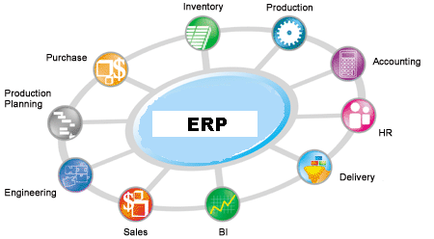
Main use of DBMS in Organizations
Enterprise applications
Enterprise resource planning (ERP) systems
Enterprise Resource Planning (ERP) system integrates systems across an enterprise to streamline workflow, share information among different departments, and provide insight into a business’s operations.

Slide 12
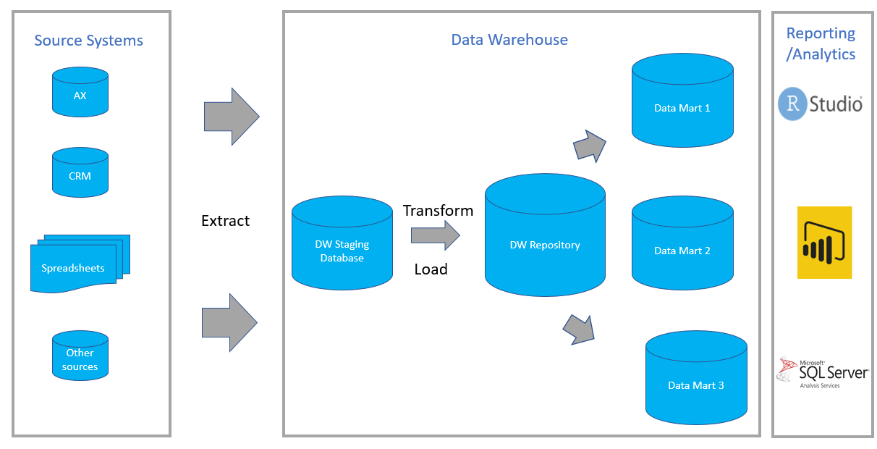
Main use of DBMS in Organizations
Enterprise applications
Data warehousing implementations
Database used for reporting and data analysis. Integrating data from one or more disparate sources creates a central repository of data, a data warehouse
Source: Stoneridge software,2019
Notes:
https://www.educba.com/data-warehouse-implementation/

Slide 13
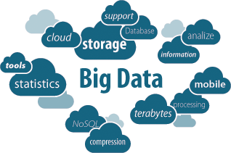
Main use of DBMS in Organizations
Enterprise applications
Big Data Analytics
The process of collecting, organizing and analyzing large sets of data to discover patterns and useful information

Slide 14
Initial Vocabulary
Data: raw facts about things and events
Information: transformed data that has value for decision making
Essential to organize data for retrieval and maintenance
Which are the top 100 selling products?
Increase prices all food product by 10% due to increase in price of sugar

Slide 15
Database Characteristics
Persistent
Lasts a long time (not transient)
Lasts longer than the execution of a computer program
Data is stored to a persistent media once a transaction is completed (committed) so that it can be retrieved when needed
Inter-related
Stores entities and relationships among the entities
Entity: cluster of data about a topic (customer, student, loan)
Relationship: connection among entities
Shared
Multiple uses: hundreds to thousands of data entry screens and reports
Multiple users: many people simultaneously use a database

Slide 16
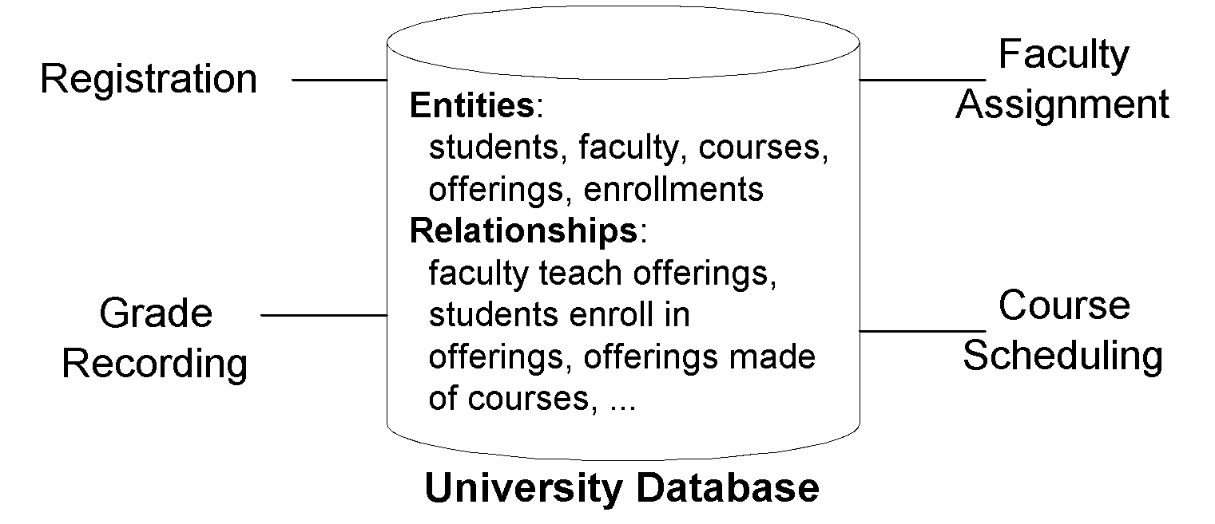
University Database
Notes:
To depict these characteristics, let us consider a number of databases. We begin with a simple university database (Figure 1) since you have some familiarity with the workings of a university. A simplified university database contains data about students, faculty, courses, course offerings, and enrollments. The database supports procedures such as registering for classes, assigning faculty to course offerings, recording grades, and scheduling course offerings. Relationships in the university database support answers to questions such as
∙ What offerings are available for a course in a given academic period?
∙ Who is the instructor for an offering of a course?
∙ What students are enrolled in an offering of a course?

Slide 17
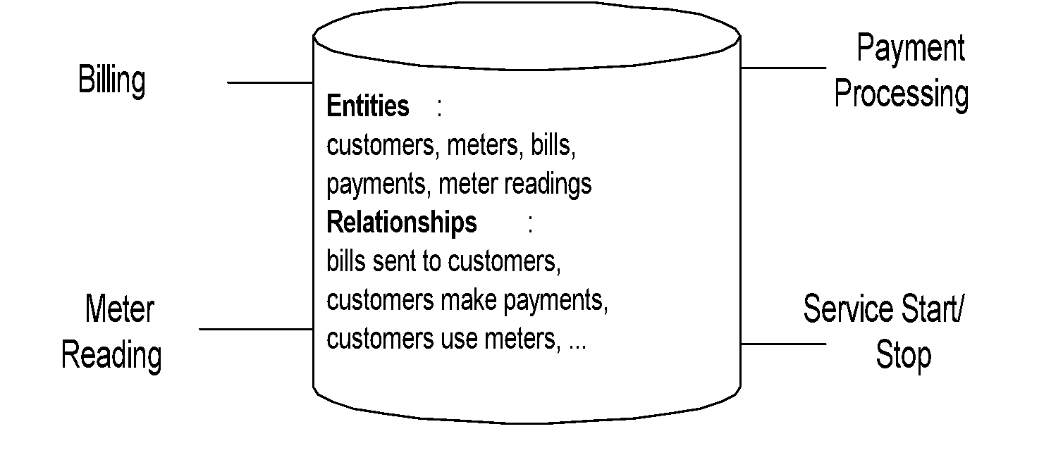
Water Utility Database

Slide 18
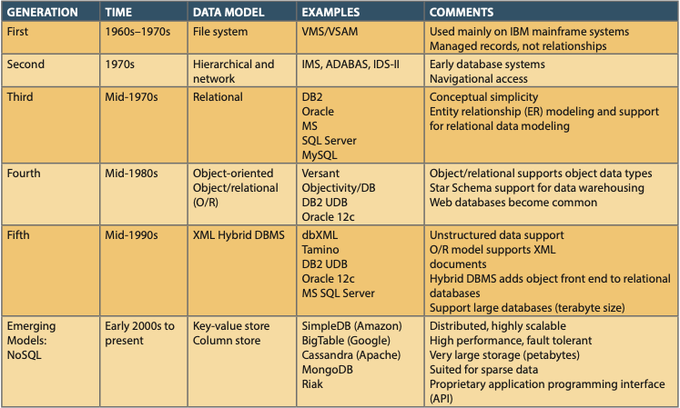
Database Technology Evolution
Database Systems: Design, Implementation, & Management, 12th Edition, Rob & Coronel
Additional Reading: What is DBMS Advantages and Disadvantages of DBMS.htm
Notes:
The first generation supported sequential and random searching, but the user was required to write a computer program to obtain access.
The second generation products were the first true DBMSs as they could manage multiple entity types and relationships. However, to obtain access to data, a computer program still had to be written. Second generation systems are referred to as “navigational” because the programmer had to write code to navigate among a network of linked records.
Third generation systems are known as relational DBMSs because of the foundation based on mathematical relations and associated operators. Optimization technology was developed so that access using non-procedural languages would be efficient.
Fourth generation systems can store and manipulate unconventional data types such as images, videos, maps, sounds, and animations. Because these systems view any kind of data as an object to manage, fourth generation systems are sometimes called “object-oriented” or “object-relational”. In addition to the emphasis on objects, the Internet is pushing DBMSs to develop new forms of distributed processing.

Slide 19
Purpose of Database System
Prior to the availability of DBMSs, database applications were built on top of file systems – coded from the ground up.
Drawbacks of this approach:
Difficult to reprogram sophisticated processing, i.e., concurrency control, backup and recovery, security
Re-inventing the wheel can be expensive and error-prone
“We need a truck, lets design and build our own truck.”
i.e. Need to rewrite code for a program/system that is already working but not compatible with the current system
This leads to:
Data redundancy and inconsistency
Multiple files and formats
A new program to carry out each new task
Integrity constraints (e.g. account balance > 0) become embedded throughout program code, etc.
Database systems offer proven solutions for the above problems.

Slide 20
Applications of database
DBMS in application development environment

Slide 21
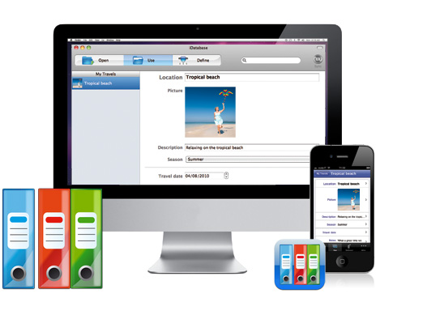
The Range of Database Applications
Personal databases

Slide 22
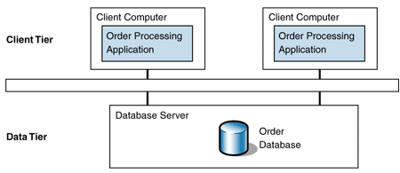
The Range of Database Applications
Two-tier Client/Server databases

Slide 23
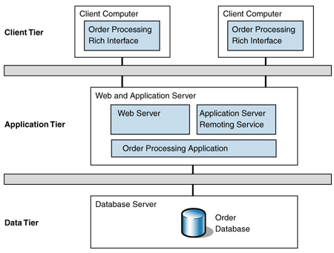
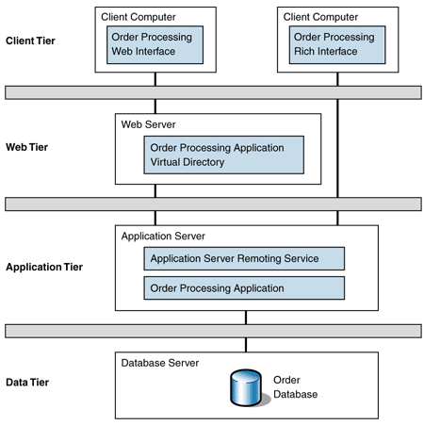
The Range of Database Applications
Multitier Client/Server databases
3-tier
4-tier

Slide 24
Applications, the DBMS, and SQL
Applications are the computer programs that users work with.
The Database Management System (DBMS) is a software suite that creates, processes, and administers databases.
Structured Query Language (SQL) is an internationally recognized standard database language that is used by all commercial DBMSs.

Slide 25
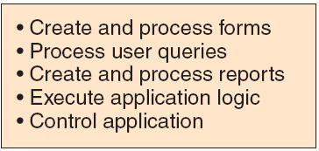
Database Applications
A DBMS has features to:
(you will learn some of these features in the lab practical and in other courses)

Slide 26
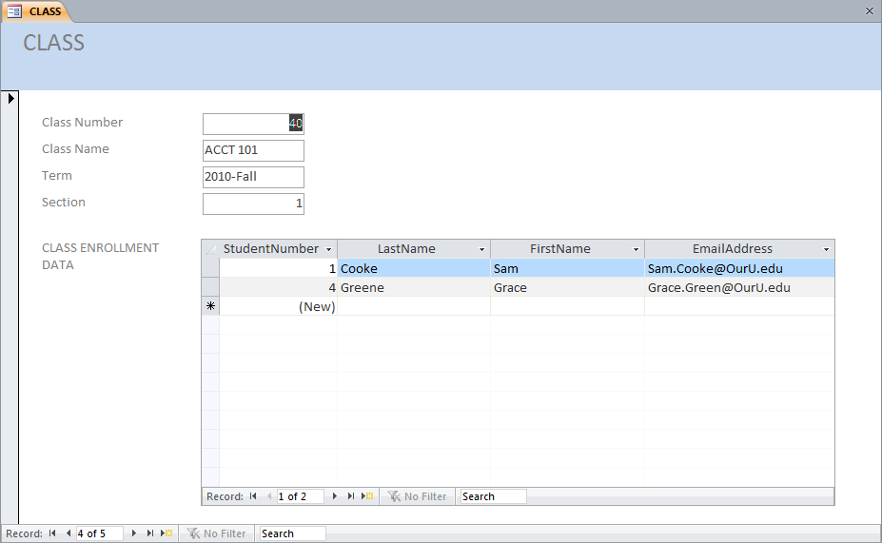
Database Applications—Forms
A very useful reporting tool

Slide 27
Database Applications—Queries
SELECT LastName, FirstName, EmailAddress
FROM STUDENT
WHERE StudentNumber > 2;
Very simple English-like phrases that can be easily understood even by the end-users

Slide 28
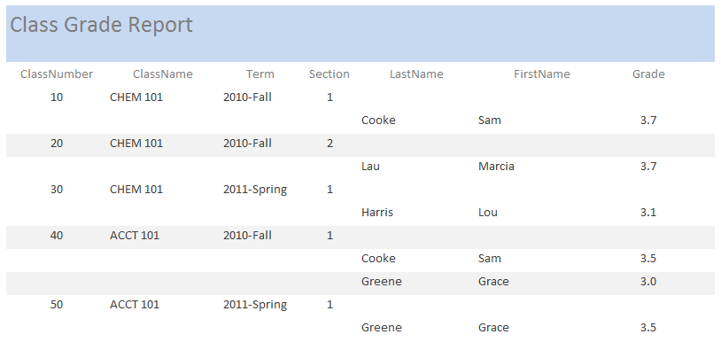
Database—Reports
Reports in a variety of formats can be created in an ad-hoc manner

Slide 29
Summary
Examples of database applications
Definitions of terms
History and development of database processing
Purpose of database applications
Please refer to reference books and additional reading materials for more knowledge and information.

